Slide 1
Internet of Things(CS5453)
HVAC Controller
Pratik Madhukar Lahase (CS20MTECH11003)
Tahir Ahmed Shaik (CS20MTECH14007)
Ashish Kishor (CS20MTECH11002)
Indian Institute of Technology, Hyderabad
1
Notes:
1
Sukanya

Slide 2
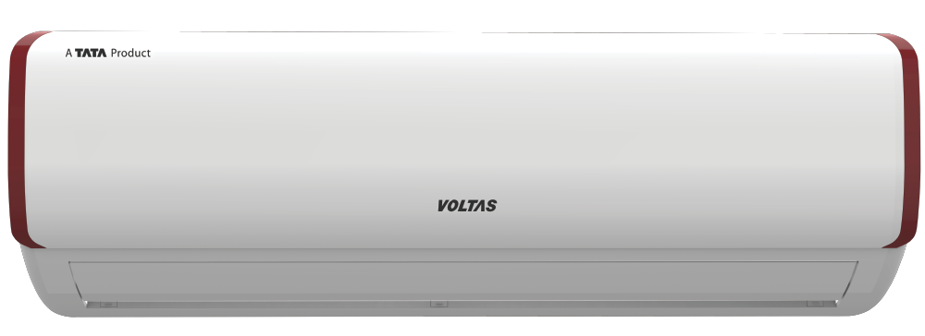

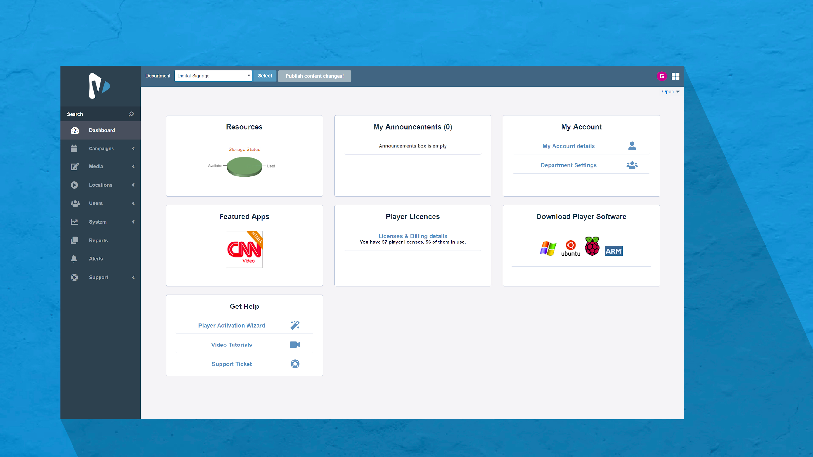



System Architecture
Air Conditioner Python Client
State : ON/OFF
Temp : 16 to 28* C Temp (+/-)
Fan Speed : [1 to 4]
User Interface
Webpage
Sensor
Implemented in python
Generates Temp b/w 15*C to 49*C
Get Data & Update User Interface
Random Number Logic
MQTT
CS5453: Internet of Things
Jan 2021
Central Hub/
Coordinator
Python Server
MQTT
The Communication Services b/w all the appliances, the thermostat and the central hub is handled by AWS IoT Core MQTT
Fan Python Client
State: ON/OFF
Speed : 1 to 5
MQTT
Rules Engine in CENTRAL HUB
Some Rules logic based upon temp
If temp <= 21* C
Do ……
eyc
Room Heater
Python Client
State : ON/OFF
Temp : 28* C to 35* C(+/-)
Log.txt
{timestamp} <temp>
2
Notes:
2
Sukanya

Slide 3

Data Flow
Timer
Wait 5 minutes
Temp Sensor
Central Hub/ Gateway
Parms{
AC: -------
FAN: ------
Heater:-----
Rule engine
{
Decide params
}
.
Random (15,49) * C temperature
Decided Parameters sent to devices
3
Notes:
3
Sukanya

Slide 4
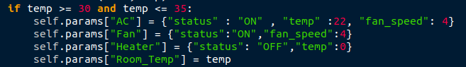
Rule Engine Logic
.
4
Notes:
4
Sukanya

Slide 5
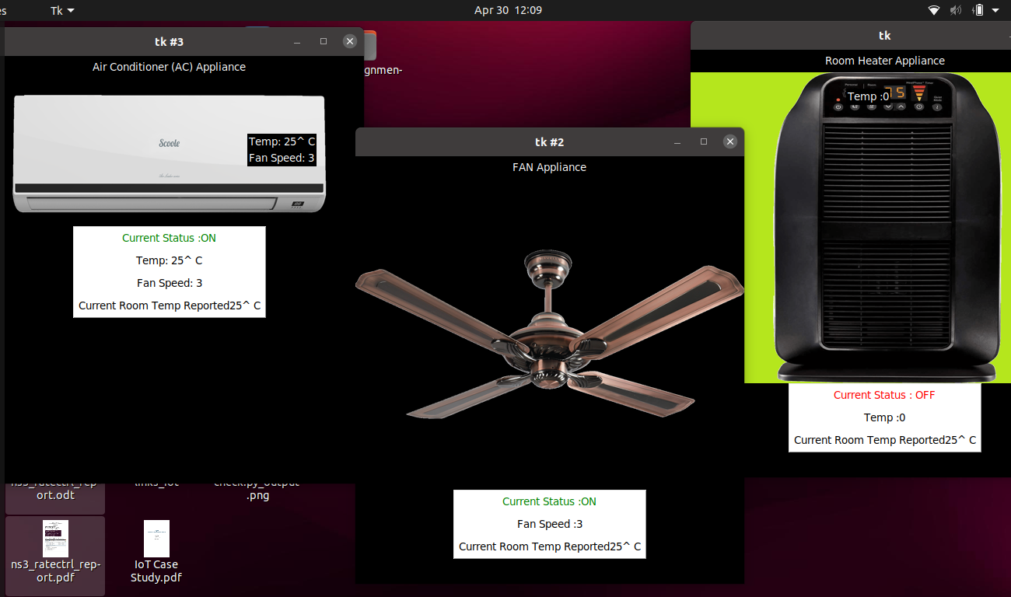
Interfaces of Appliances Modules
.
5
Notes:
5
Sukanya

Slide 6
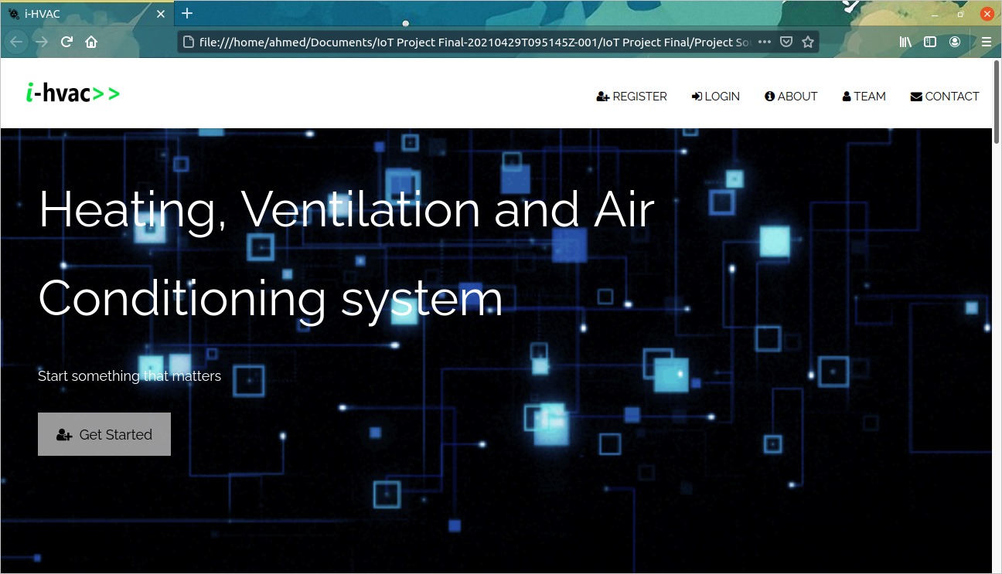
User Interface: Home Page
6
Notes:
6
Sukanya

Slide 7
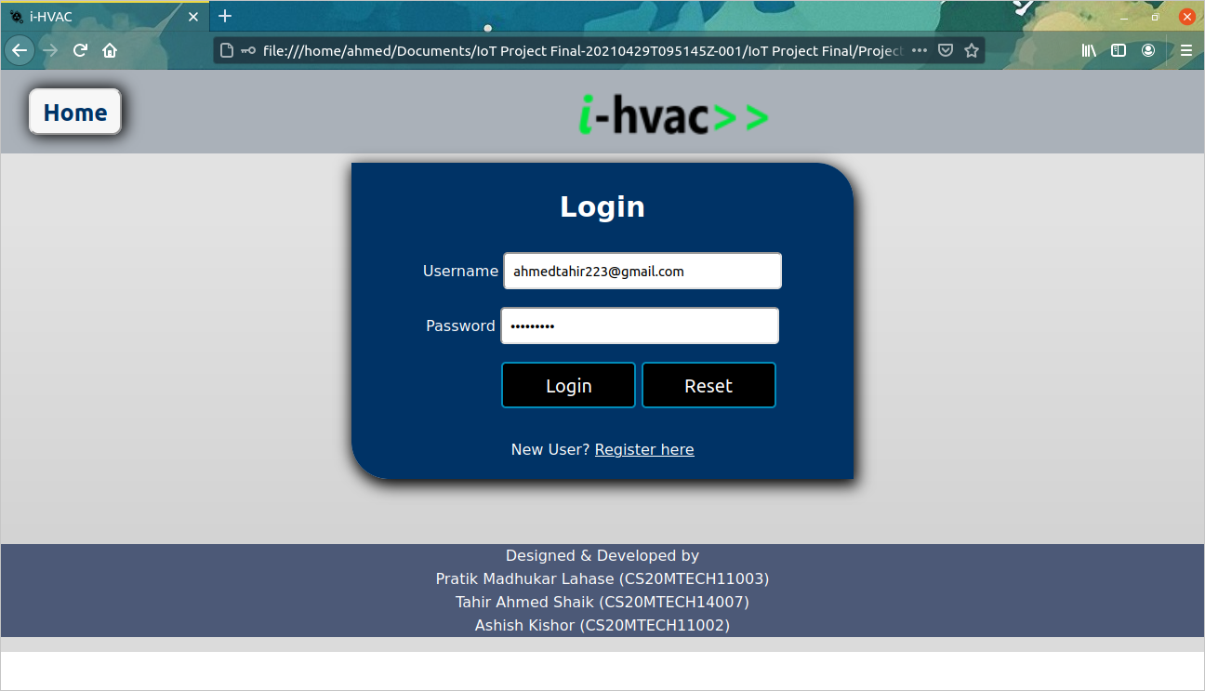
User Interface: Login Page
7
Notes:
7
Sukanya

Slide 8
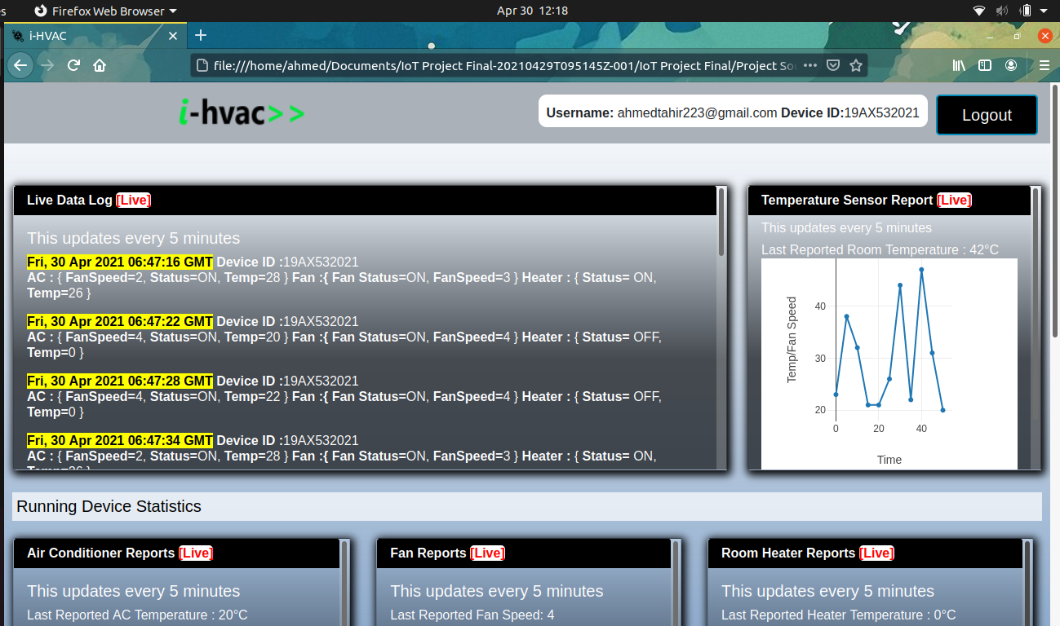
User Interface: Dashboard
8
Notes:
8
Sukanya

Slide 9
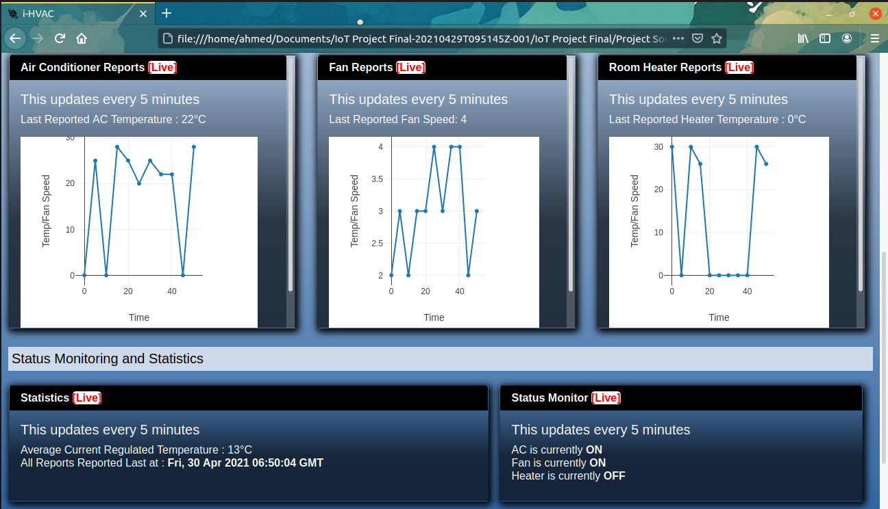
User Interface: Contd..
9
Notes:
9
Sukanya

Slide 10
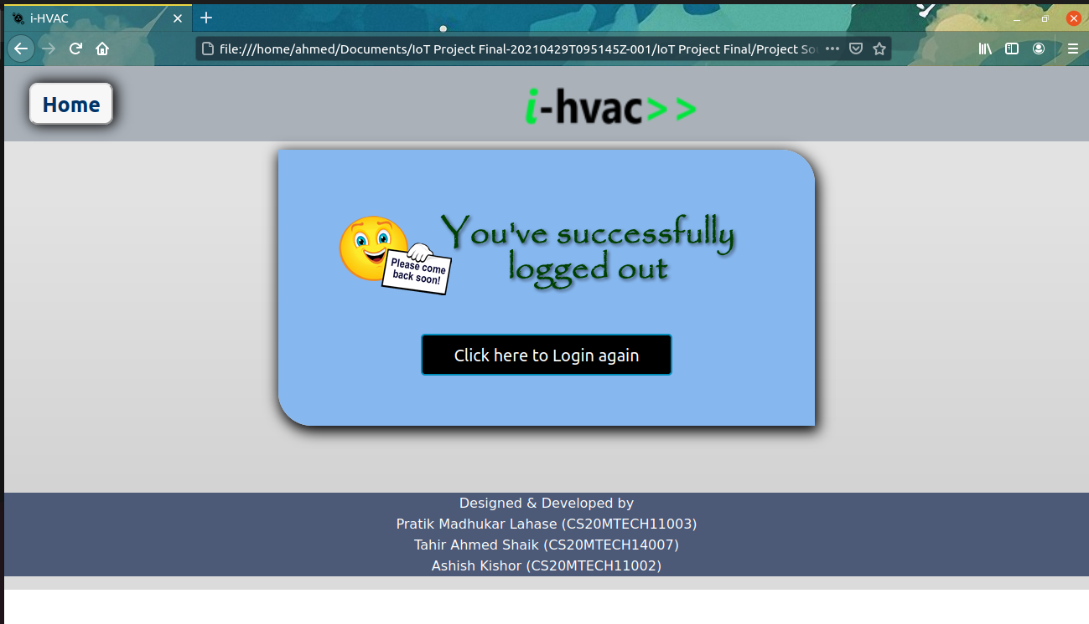
User Interface: Contd..
10
Notes:
10
Sukanya

Slide 11
References
[1] https://en.wikipedia.org/wiki/Heating,_ventilation,_and_air_conditioning
[2] https://en.wikipedia.org/wiki/Thermostat
[3] https://www.explainthatstuff.com/thermostats.html
[4] M. Fukuta, K. Matsui, M. Ito and H. Nishi, "Proposal for home energy management system to survey
individual thermal comfort range for HVAC control with little contribution from users," 2015 IEEE 13th International Conference on Industrial Informatics (INDIN), 2015, pp. 658-663, doi: 10.1109/INDIN.2015.7281813.
11
Notes:
11
Sukanya

Slide 12



Appendix
12
Notes:
12
Sukanya

Slide 13
THANK YOU!
13

